Slide 1



PrEP uptake among pregnant and postpartum women: results from a large implementation program within maternal child health (MCH) clinics in Kenya
J. Kinuthia^{1,2}, J. Pintye², F. Abuna³, H. Lagat³, K. Mugwanya², J. Dettinger², M. Serede³, J. Sila³, J.M. Baeten², G. John-Stewart⁴,
PrEP Implementation for Young Women and Adolescents (PrIYA) Program
1Kenyatta National Hospital, Nairobi, Kenya, 2University of Washington,, Seattle, United States, 3University of Washington--Kenya, Nairobi, Kenya,
No Conflict of interest to declare
PrIYA is funded through the DREAMS Innovation Challenge.
Disclaimer: This presentation was funded by a grant from the United States Department of State as part of the DREAMS Innovation Challenge, managed by JSI Research & Training Institute, Inc. (JSI). The opinions, findings, and conclusions stated herein are those of the authors and do not necessarily reflect those of the United States Department of State or JSI.

Slide 2
HIV incidence is high among
pregnant & postpartum women
HIV incidence similar to other high risk groups
Increased risk in pregnancy and postpartum
  hormonal and physiological changes
  external partnerships
Low male partner engagement with PMTCT
HIV uninfected women often unaware of partner HIV status & do not perceive risk
Drake et al (2014); Shannon et al (2015); Kimani et al (2008); Baeten et al (2014); Msuya 2008

Slide 3
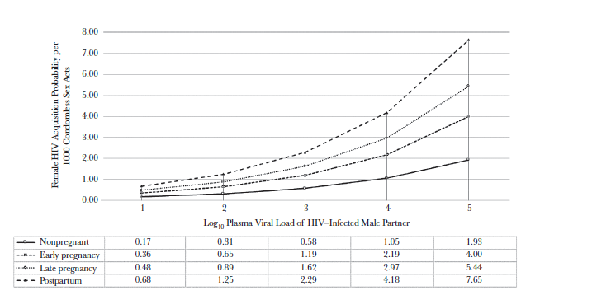
HIV risk per unprotected coital act increased in pregnancy & postpartum
Thomsom et al 2018

Slide 4
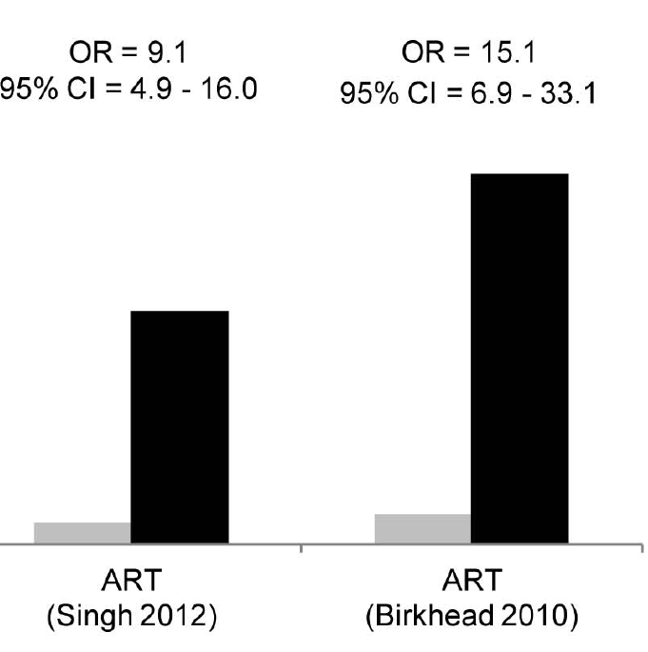

Primary HIV prevention in pregnancy & postpartum critical for eMTCT
~40% of infant HIV infections due to acute maternal HIV
Women with acute HIV have higher MTCT
  higher viral load
  absent HIV immune responses
  no maternal or infant ARVs
Identification of HIV-infected women & initiation of ART
Initiatives promoting primary HIV critical to protect HIV negative women & eMTCT
Dinh et al 2015; Johnson et al 2012; Drake et al 2014

Slide 5
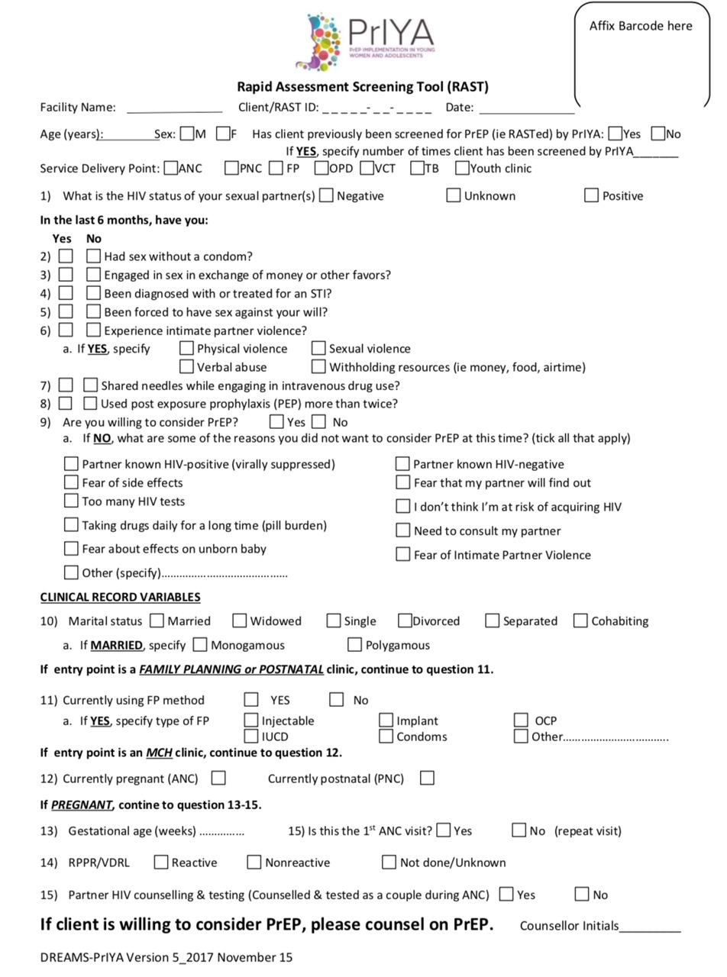
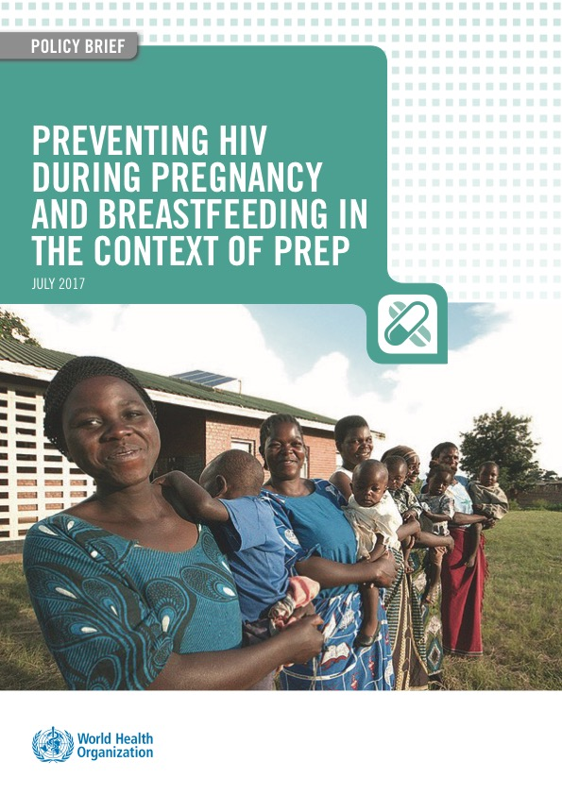
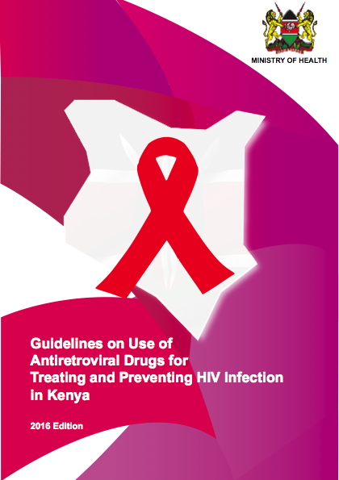
WHO and Kenyan guidelines support PrEP in pregnancy and postpartum

Slide 6

Unanswered questions regarding PrEP in pregnancy & postpartum
Will pregnant/breastfeeding women recognize risk for HIV?
Which pregnant women should be offered or receive PrEP?
Will women accept PrEP?
  Who accepts PrEP?
Will women adhere to PrEP?
  Who adheres?
Insert photo here

Slide 7
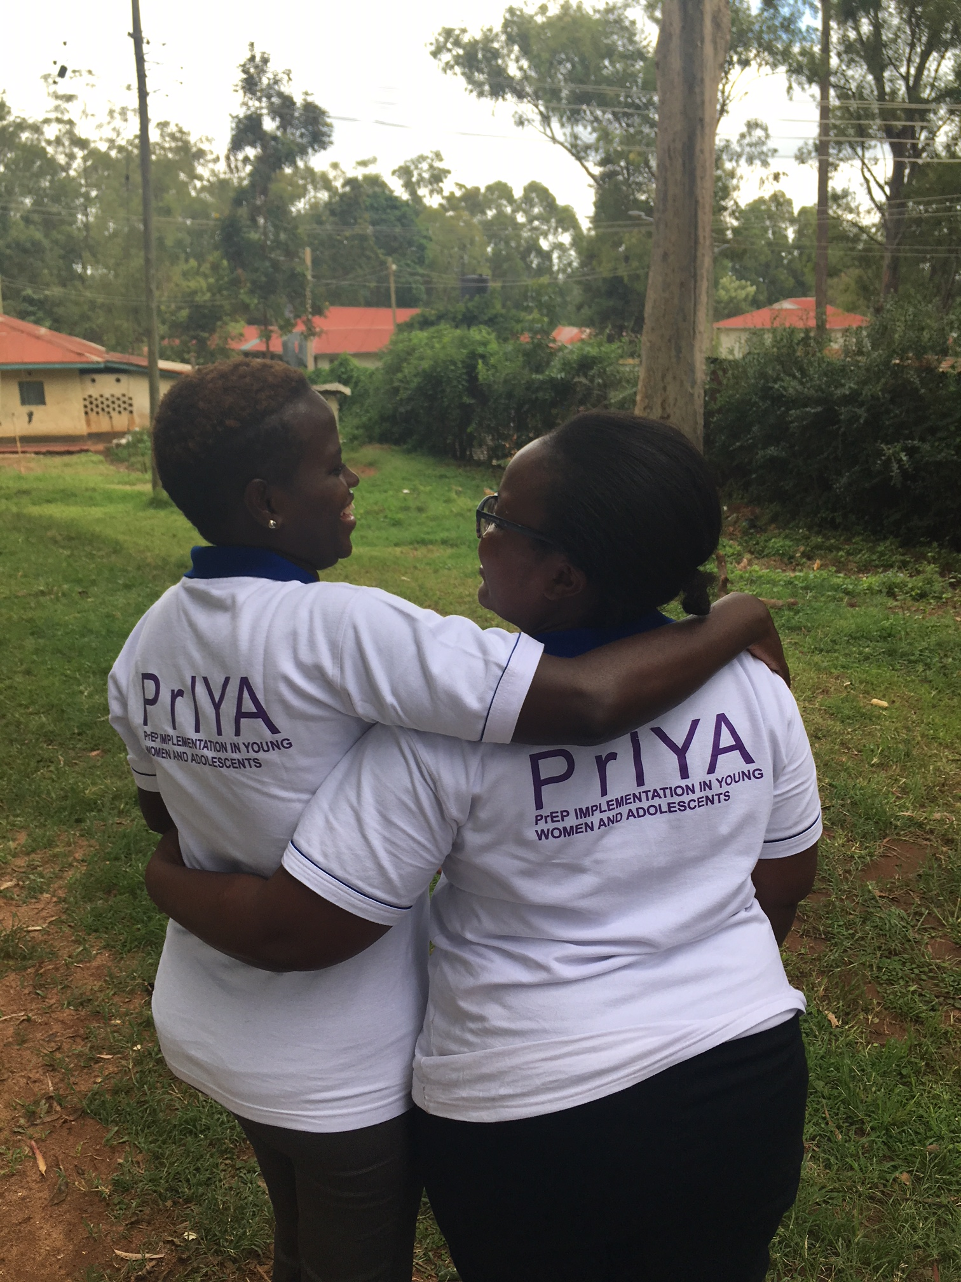
Implementation program delivering PrEP within MCH and FP clinics in Kisumu, Kenya
PrIYA is part of the DREAMS Innovation Challenge funded by PEPFAR &
managed by JSI Research & Training Institute, Inc

Slide 8
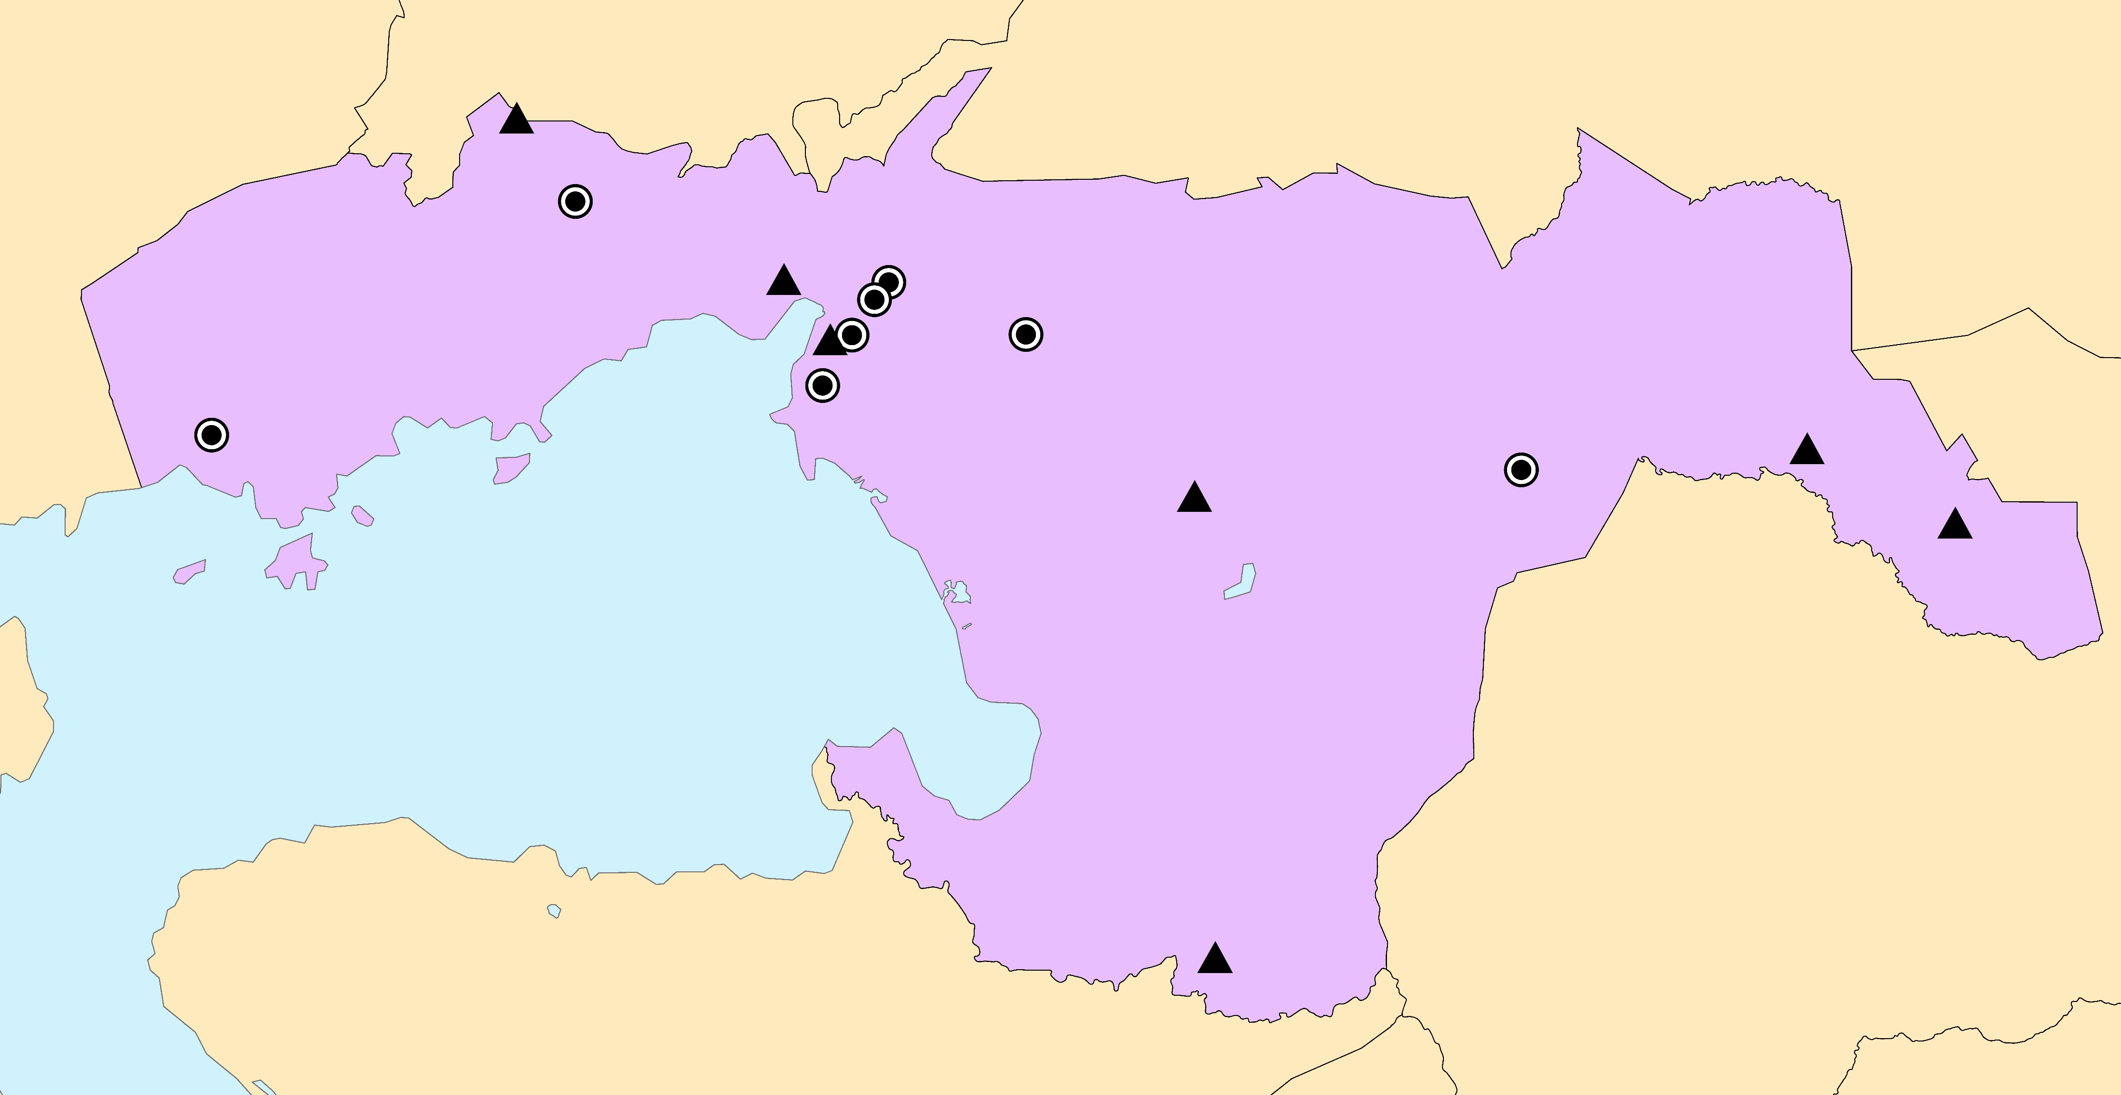
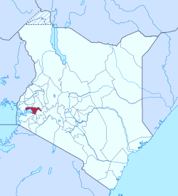
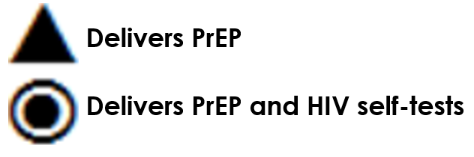
Distribution of 16 PrIYA sites across Kisumu County, Kenya
Ahero
Airport
Awasi
Chiga
Chulaimbo
KCH
Koru
Lumumba
Manywanda
Maseno
Migosi
Muhoroni
Nightingale
Nyalenda
Nyakach
Rabuor

Slide 9
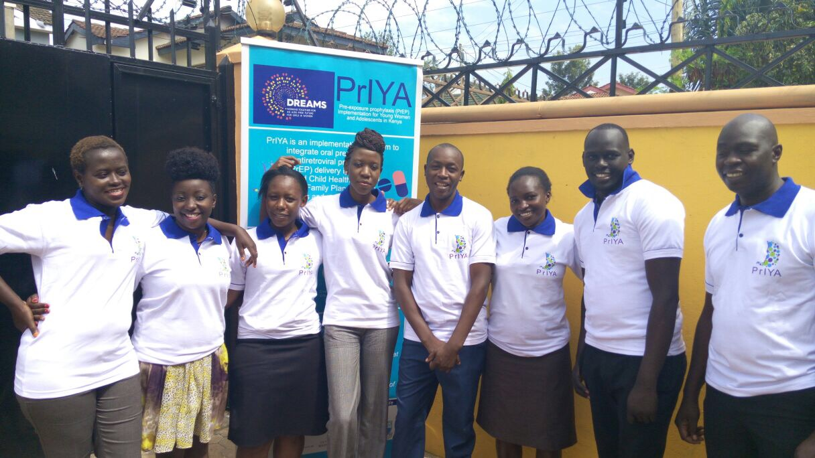
AIM
Evaluate PrEP acceptance and cofactors of uptake among pregnant and postpartum women offered PrEP within routine MCH

Slide 10
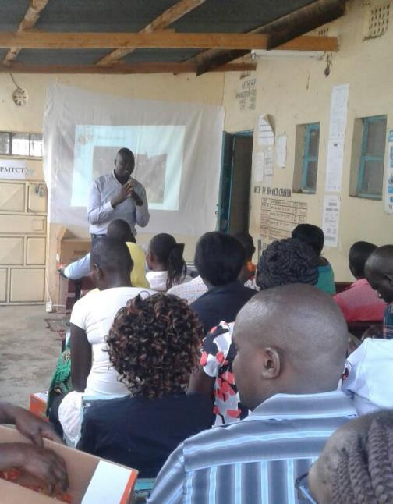
Methods
HIV-uninfected women seeking routine ANC and PNC
Screened for behavioral risk factors and willingness to consider PrEP
System for PrEP delivery in MCH
  co-delivery (one nurse)
  coordinated (two nurses)
Waiting area & registration
Sequential
HTS
co delivery
MCH services
Creatinine testing
PrEP initiating & dispensing

Slide 11
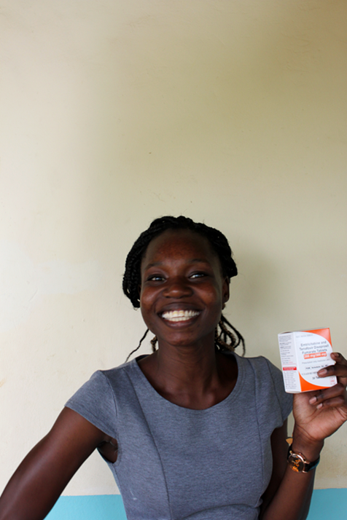
Methods (cont’d)
Dispensed PrEP
  same visit
  within MCH clinics
  willing to initiate and medically eligible
Logistic regression models to determine cofactors of uptake
Analyzed data from Nov 2017-May 2018

Slide 12
Results
Women assessed for behavioral risks & willingness to consider PrEP
N=9171
Pregnant (52%) Postpartum (48%)
Did Not Initiate PrEP
N=7178 (78%)
Pregnant (54%) Postpartum (46%)
Initiated PrEP
N=1993 (22%)
Pregnant (45%) Postpartum (55%)

Slide 13
Characteristics of women offered PrEP (n=9171)
Median (IQR) or N (%)
Age (years) | 24 (21-28)
Age <24 years | 46%
Married | 84%
Partner HIV status unknown | 34%
Gestational age (weeks)* | 26 (20-32)
First antenatal care visit* | 45%
*Among pregnant clients

Slide 14
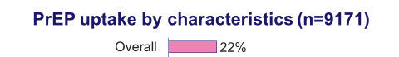
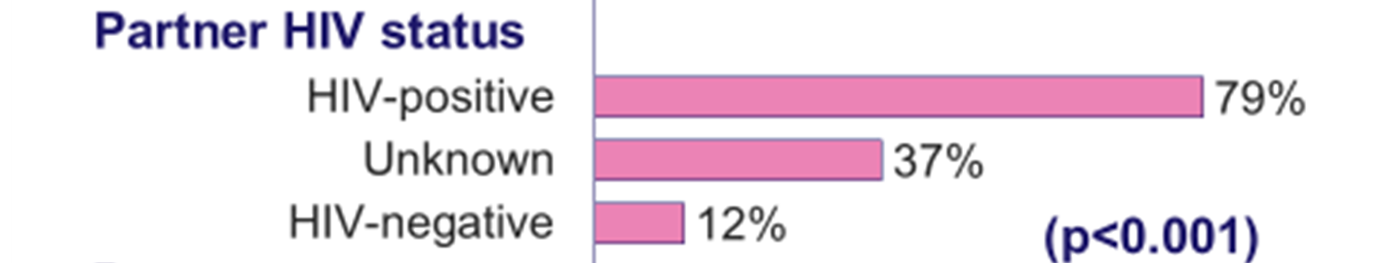
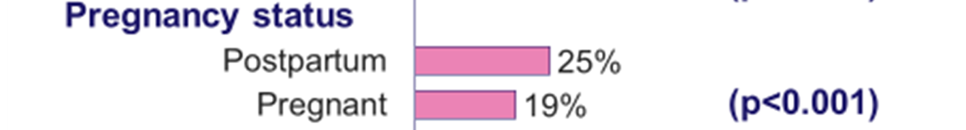
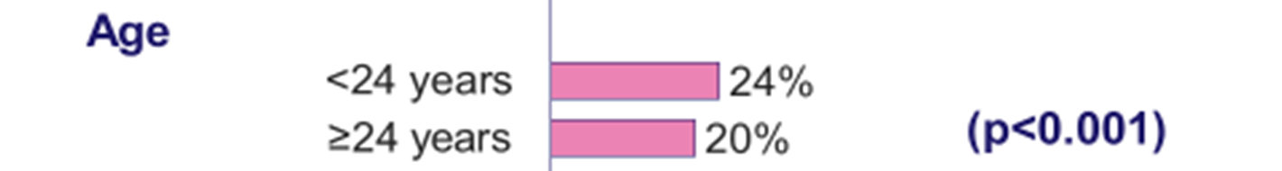


Slide 15
Correlates of PrEP initiation (n=9171)
Crude Odds Ratio (95% CI)
Transactional sex¹ | 3.1 (1.4-6.8)*
Diagnosed with STI¹ | 3.0 (1.5-6.0)*
Forced to have sex¹ | 4.7 (2.4-9.3)**
Experienced IPV¹ | 3.2 (1.4-7.2)*
Partner HIV status unknown | 3.7 (2.8-4.9)**
Age <24 years | 1.2 (1.1-1.4)*
Postpartum (vs pregnant) | 1.5 (1.0-2.1)*
*p<0.05; **p<0.001; ¹ In the last 6 months

Slide 16
Reasons for not initiating PrEP among non-initiators with risk factors for HIV (n=2092)
*Among pregnant clients

Slide 17
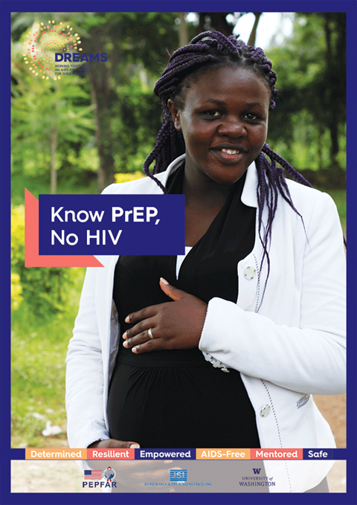
Conclusions
1 in 5 pregnant & postpartum women accepted PrEP
PrEP initiators were more likely to have HIV risk factors
IPV or fear of effects on babies were infrequently reported as barriers
One third had a partner of unknown HIV status

Slide 18
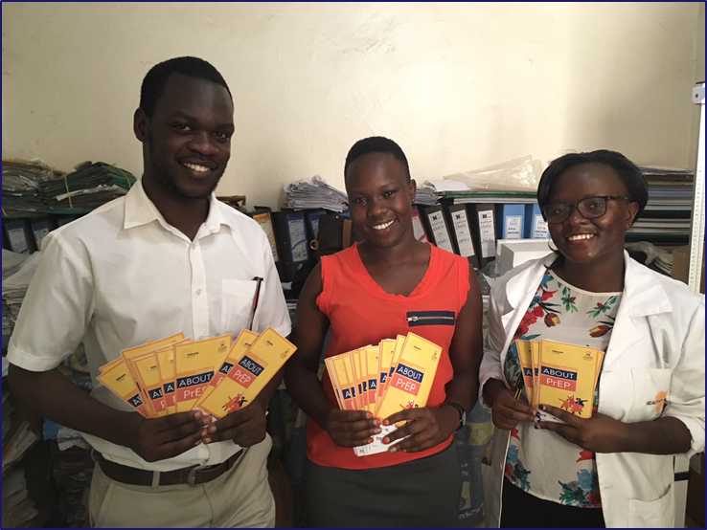
Implications
Routine MCH clinics are an important platform for PrEP delivery
Innovations are needed to increase knowledge of male partner HIV status

Slide 19
Ongoing analysis
Adherence to PrEP
Rates and reasons for discontinuing PrEP

Slide 20







Acknowledgments
We gratefully acknowledge all of the PrIYA Program participants.
PrIYA Program staff, the Kenyan Ministry of Health, and Kisumu County Government.
PrIYA is funded by the United States Department of State as part of the DREAMS Innovation Challenge, managed by JSI Research & Training Institute, Inc.
This presentation was funded by a grant from the United States Department of State as part of the DREAMS Innovation Challenge, managed by JSI Research & Training Institute, Inc. (JSI). The opinions, findings, and conclusions stated herein are those of the authors and do not necessarily reflect

